Slide 1


Qatari Leadership and Talent Summit
Saudi Vision 2030:
Building the Capabilities
Professor William Scott-Jackson
wsj@oxfordstrategicconsulting.com
+447785110910
Notes:
I’d like to make sure I meet your needs so how many here are from Saudi Government? How many in training or education? How many from companies wanting to succeed in Saudi?

Slide 2
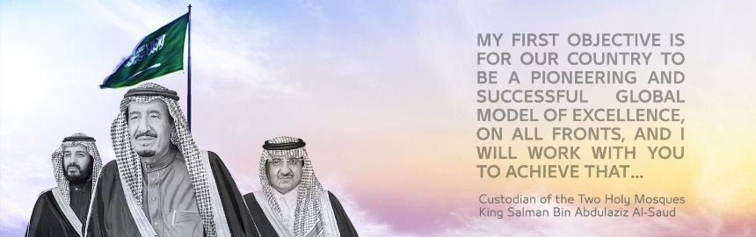
Agenda
Saudi Vision 2030: Objectives, context and opportunity
The key strategic sectors, the key strategic capabilities
Building the capabilities for Saudi Vision 2030
  How can you contribute?
  How can you benefit?

Slide 3










Saudi Vision 2030:
Capability Shifts
Shift from public to private sector
Shift from imports to self-reliance in products and services
Shift from oil to other key sectors
Shift from migrant labour to development of national human capital

Slide 4


Strategic Capabilities:
What are they?
Differentiating Strategic Capabilities (DiSCs)
Innovative
Capabilities that provide sustainable competitive advantage
‘better than the best’
Rare, hard to copy, valuable
Friendliness
Fundamental Capabilities
Skills, expertise, sector/job specific
Capabilities needed to reach world-class ‘best practice’ in a market
Enabling Capabilities
Leadership
Capabilities needed in every sector/discipline
IT literacy
Human resource management

Slide 5

Saudi Vision 2030 and Transformation Plan
Public sector
(4.2m)
Private sector
(1.6m)
Unemployed
(11% = .6m)
2015
Saudi labour force 6.4m
2m
4m
6m
8m
~2030
Public sector
(reduce by 20% = 3.4m )
Private sector
(3.9m)
Unemployed
(9% = .7m)
Saudi labour force 8.1m
2m
4m
6m
8m
Increase in private sector employment of nationals of 2.3m!
Most of the 8.1m are currently aged between 5 and 20.
A huge development challenge/opportunity.
* Data from Transformation Plan, Saudi Labor Market Outlook (Jadwa Investment), General Authority for Statistics and SAMA

Slide 6
Transformation Plan: Selected sectors and required capabilities
**
*
*
* McKinsey Global Institute. 2015. Saudi Arabia Beyond Oil
** Mutairi 2015 Healthcare workforce challenges KSA

Slide 7

Military manufacturing:
Requirement for skilled Saudis
We plan to manufacture half of our military needs within the Kingdom to create more job opportunities for citizens…
Our aim is to localize over 50 percent of military equipment spending by 2030 …
We will support Saudi companies with promising growth opportunities so they develop into new global leaders”
$1.1 bn
$56 bn
$28.5bn
BAE Systems
Revenue ($)
$26 bn
~4000
~190,000
95,000 Saudis
BAE Systems
employees
84,600

Slide 8



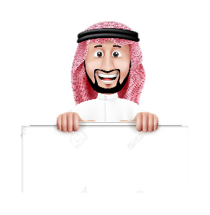
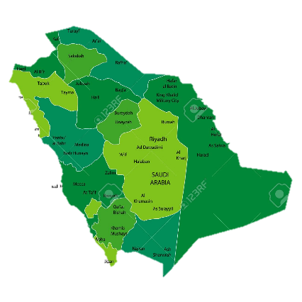

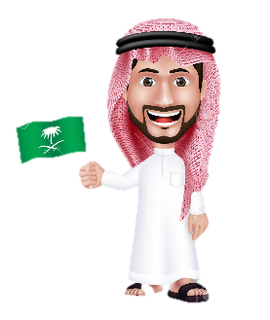





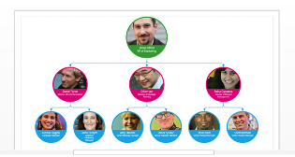


Tourism & Hospitality
800,000 Saudis: Strategic Capabilities?
Differentiating Strategic Capabilities (DiSCs)
Welcome to Saudi Arabia!
Every Saudi takes pride in showing off their country
Hospitality recognised as top prestige occupation
Saudis renowned as friendly and hospitable
Fundamental Capabilities
Tour guides
Chefs
Hotel Managers
Enabling Capabilities
Human Resources
Leadership
Attracting, developing retaining national talent
IT

Slide 9






The DiSC process
How to build Differentiating Strategic Capabilities in Tourism?
Hospitality recognised as top prestige occupation
Set up world-class University of Tourism
National award for exceptional Hospitality
Serving country, society and family
Overseas postings to world-class hotels
Welcome to Saudi Arabia!
Every Saudi takes pride in showing off their country
Saudis renowned as friendly and hospitable
Instill pride in tourism as respected career
Business incubator and funding for Tourism entrepreneurs
Tourism and hotel management taught in High School

Slide 10






Example: building UAE national talent in Hotel and Catering (Jumeirah Group)
Gross!
What do young Emiratis think of working in Hotel and catering sector?

Slide 11
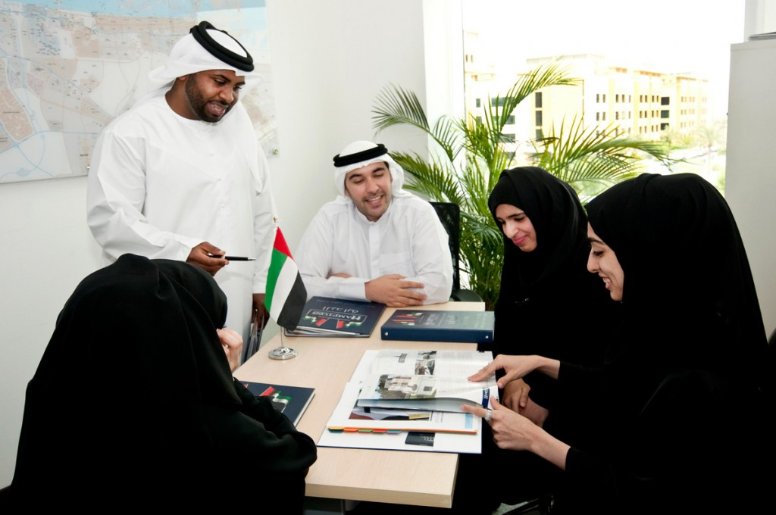
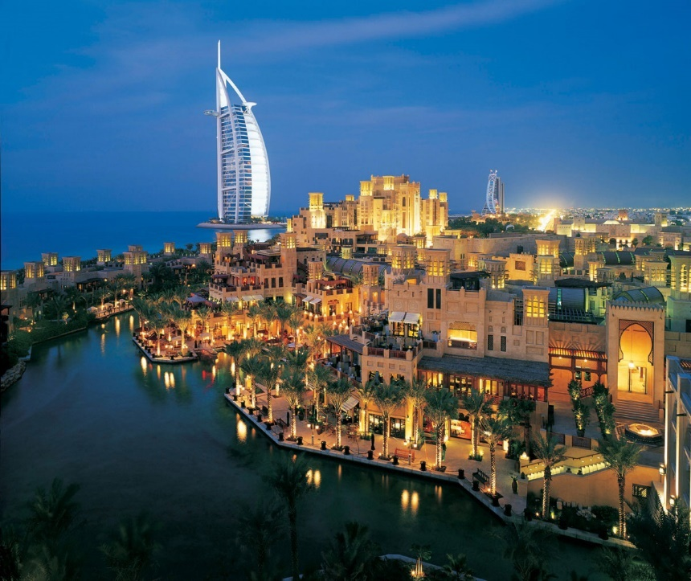
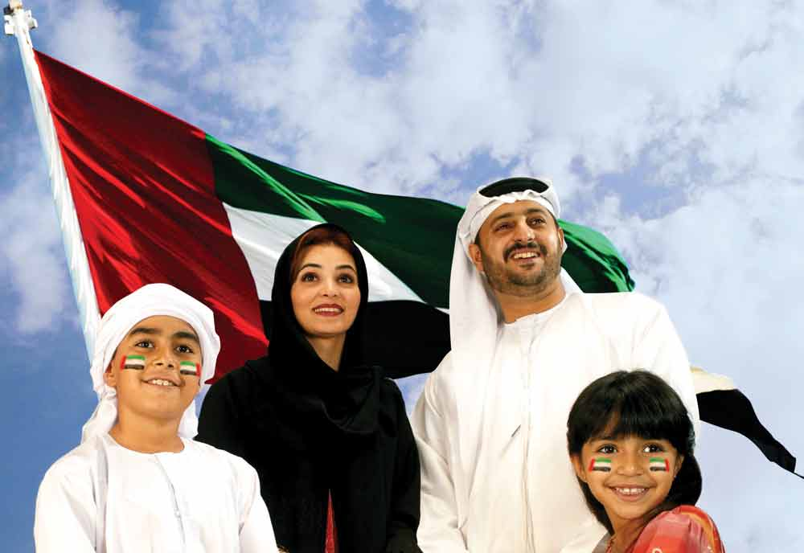
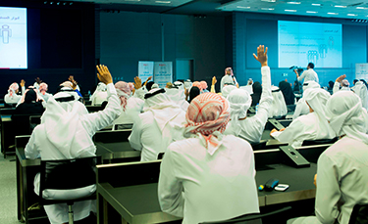
From ‘gross’ to ‘cool’!
There are many highly professional roles
The sector serves the country
Your family will be proud of you
You will learn and develop
Jumeirah Group: Best Employer in Middle East

Slide 12
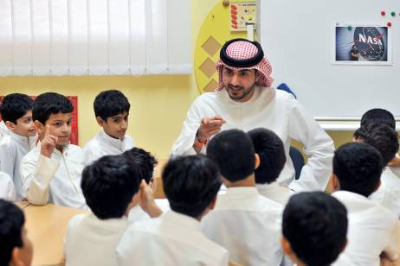
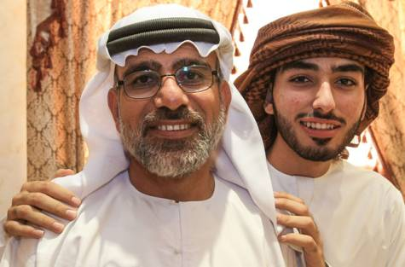
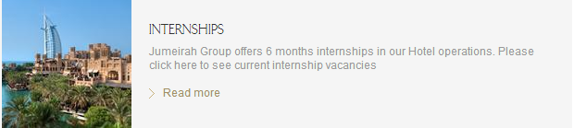

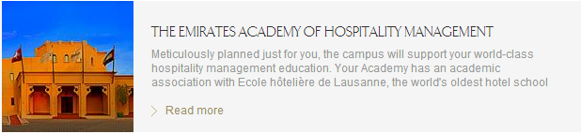
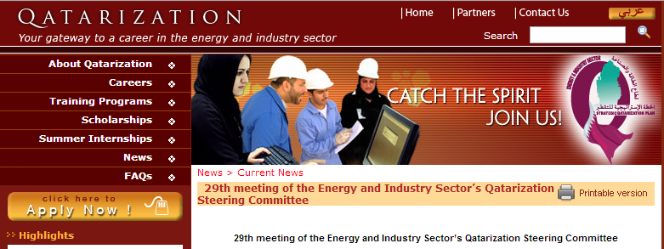
Helping employers to attract, develop and retain talent
HH Sheikh Mohammed bin Rashid Al Maktoum
“Today we approved Vision 2020 for tourism. The vision is clear, infrastructure is ready & confidence in our human resources is high. We want everyone to work as one team to achieve the goal, with positive energy, strong determination & the belief that anything is possible.”
Visit schools
Meet families
Ask advice from fathers
Sector Collaboration

Slide 13



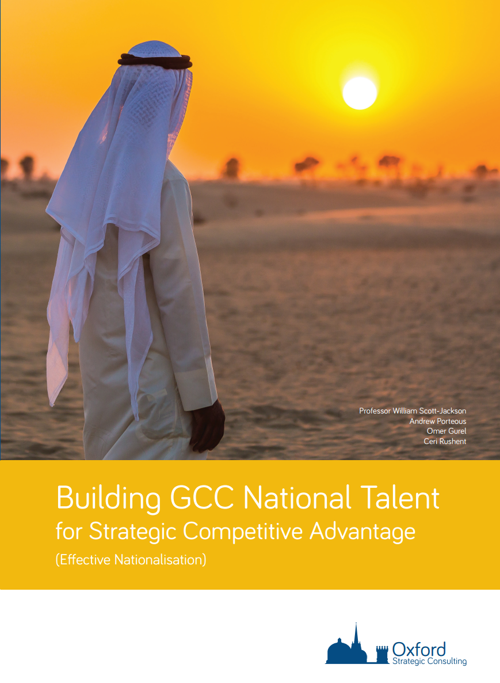
Enabling Capabilities
Human Resources
Leadership
Building National Talent
KSA needs ~250,000
world-class HR professionals
KSA needs ~1m leaders
KSA needs ~8m talented professionals

Slide 14






Enabling Capabilities:
Effective Human Resource functions
KSA needs ~250,000
world-class HR professionals
Accredit HR professionals
Ahmed al Fakieh
Certified HR Professional
Recognise and publicise exemplary HR functions
Al XYZ Group Awarded ‘best in HR’
Create/support world-class professional body
Saudi Institute of HR
Codify, simplify and implement Saudi-specific HR standards
iHR
If every member of the HR team was of world class standard how much extra do you think it would add to your organisation’s profit/effectiveness?
~12% = $14bn pa to GCC GDP

Slide 15





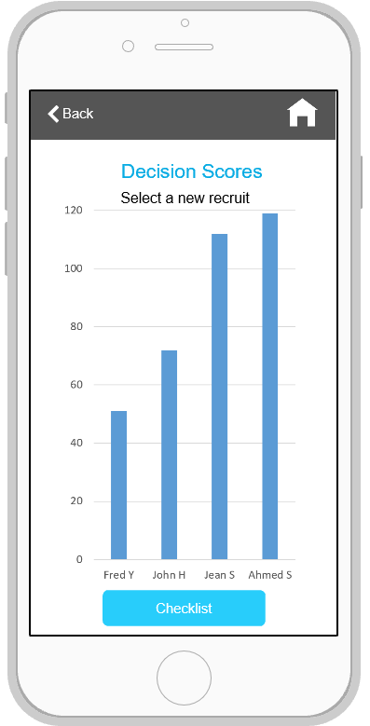
Enabling Capabilities:
Leadership
KSA needs ~1m leaders
Fast-track’ with intensive training & development
Accredit Leaders
‘Beyond Best Practice’
Abdulla Mohammed FCMI CMgr FGTAB
Grow leaders from an early age
Keep it Simple!
Practical help

Slide 16
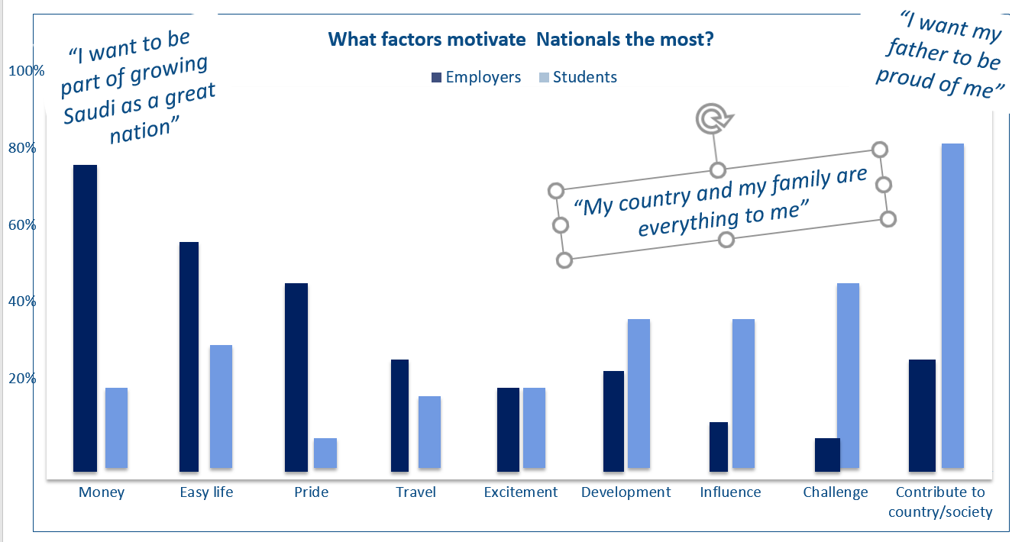



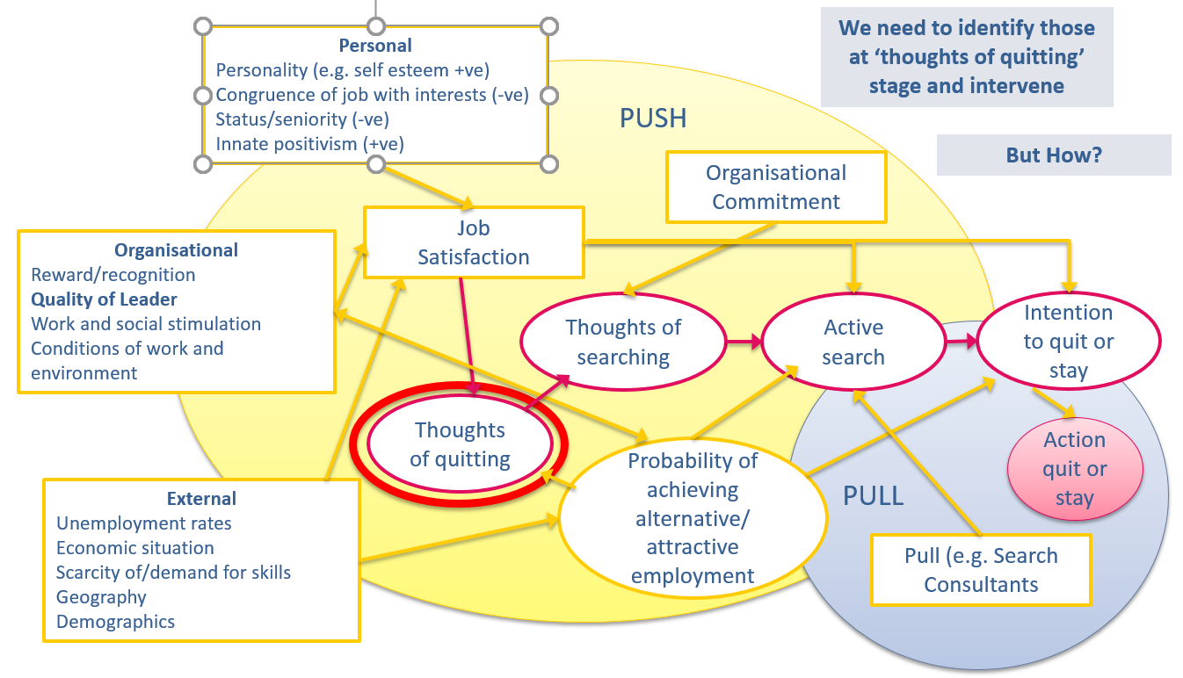
Enabling Capabilities:
Ability to attract, develop, retain national talent
Leverage the motivations and aspirations of the target market
KSA needs ~8m talented professionals
Use personal contacts, networks and recommendations to attract
Fish in different pools
Encourage self-driven development plan, ‘passport to success’, facilitated by clear career guidance and support
Monitor engagement continuously to catch ‘thoughts of quitting’ early in the process

Slide 17
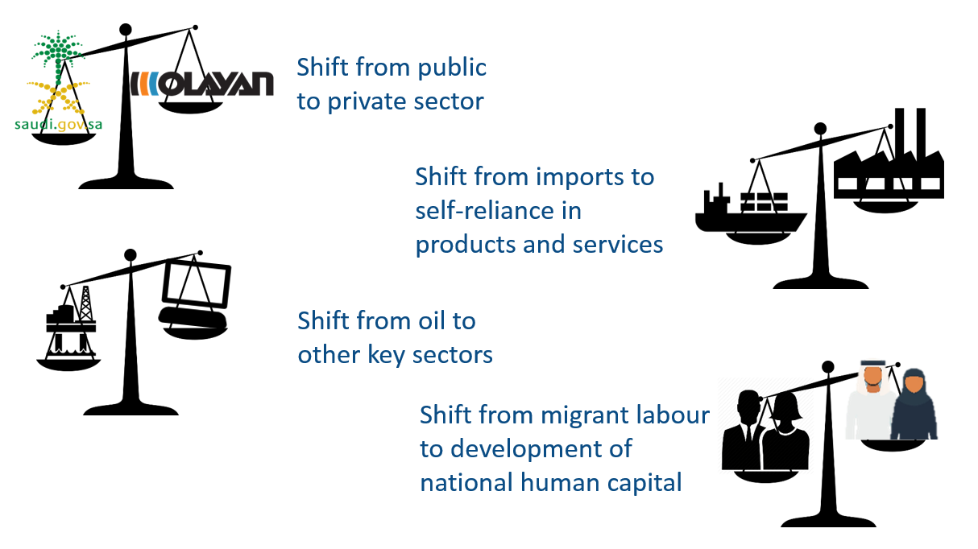
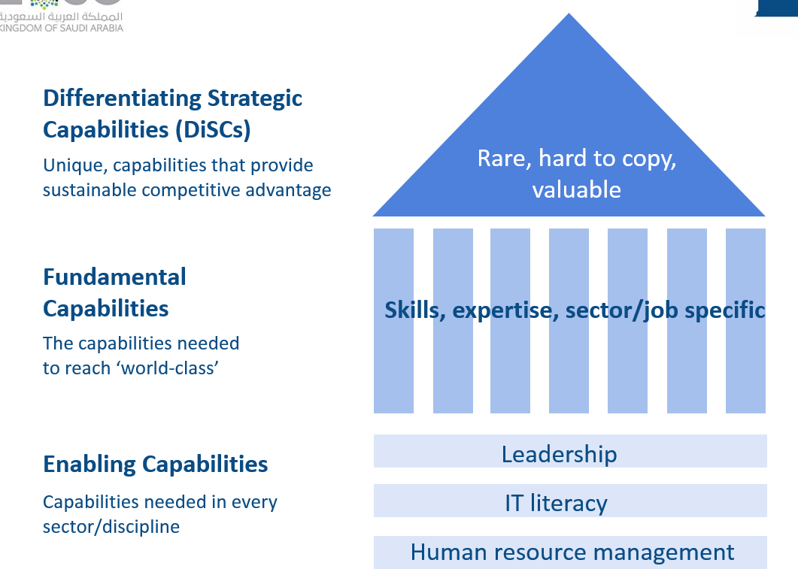
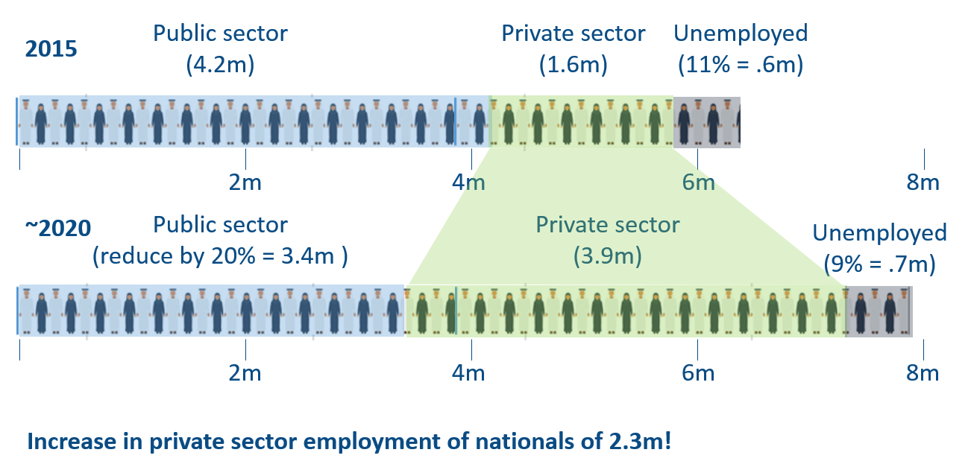
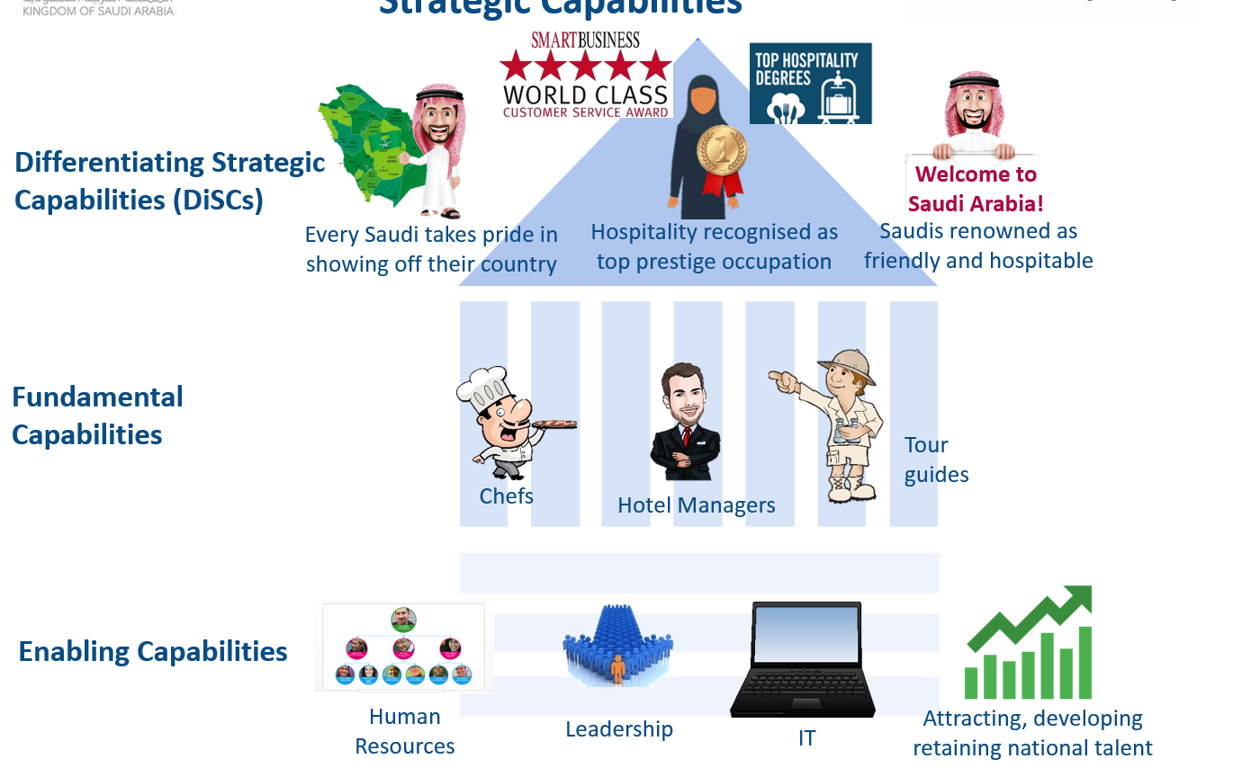
In Summary
Saudi Vision 2030 creates huge opportunities for the private sector
– and huge challenges in building human capabilities: Enabling, Fundamental and DiSCs
Enormous numbers of Saudis will need to be trained and developed for the private sector
But Saudi Vision 2030 and the Transformation Plan allow us to work out what needs to be done, the scale of the opportunity and how we can best contribute and benefit

Slide 18
شكراً
Thank you!
Professor William Scott-Jackson
wsj@oxfordstrategicconsulting.com
+447785110910

Slide 19
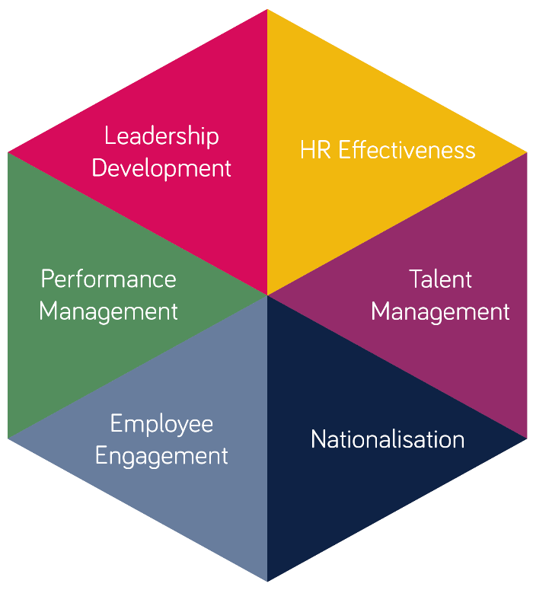




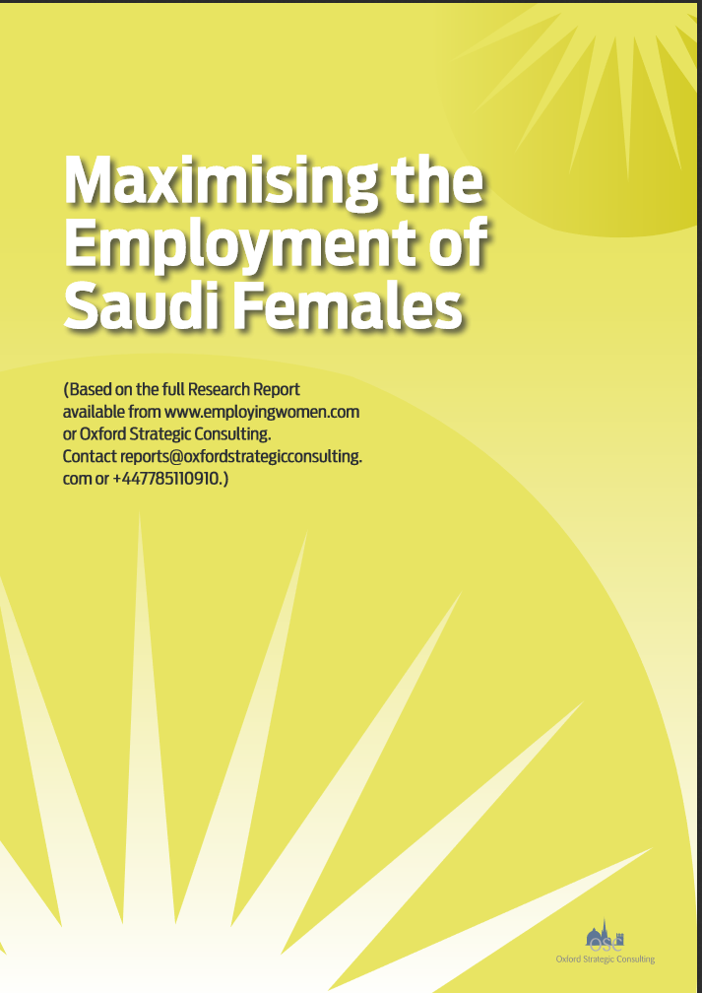

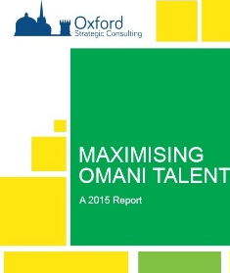


About Oxford Strategic Consulting
HR Consultancy
Research on key HR issues
MAXMISING EMIRATI TALENT
Accredited Leadership Development
Globally accredited GCC-tailored Management and Leadership Training & Development

